Slide 1
CLOUD COMPUTING: WHY CHOOSE CLOUD

Slide 2
Lesson Objectives
Explain the essential characteristics of cloud computing.
Identify the key reasons businesses migrate to cloud platforms.
Analyze the economic and operational benefits of cloud deployments.
Discuss real-world case studies where cloud deployments have driven business success.

Slide 3
NIST Cloud
https://csrc.nist.gov/pubs/sp/800/145/final

Slide 4
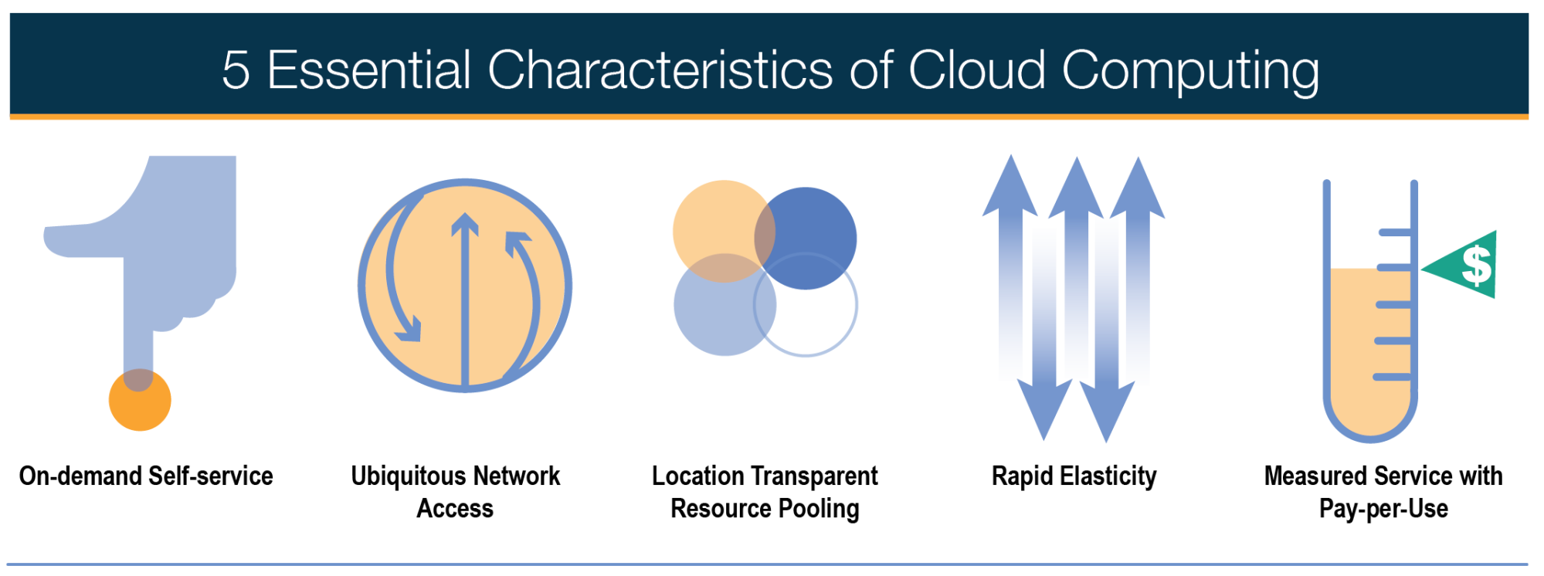
Cloud Computing Characteristics
Notes:
https://nvlpubs.nist.gov/nistpubs/Legacy/SP/nistspecialpublication800-145.pdf
Businesses primarily* migrate to the cloud for three reasons
scalability
costs
agility

Slide 5
Scalability

Slide 6
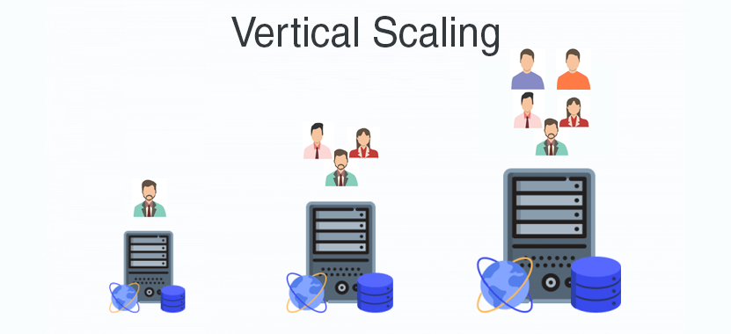
Vertical Scalability
Notes:
Advantages of Vertical Scaling
It is easy to implement
Reduced software costs as no new resources are added
Fewer efforts required to maintain this single system
Disadvantages of Vertical Scaling
Single-point failure
Since when the system (server) fails, the downtime is high because we only have a single server
High risk of hardware failures
https://www.geeksforgeeks.org/overview-of-scaling-vertical-and-horizontal-scaling/

Slide 7
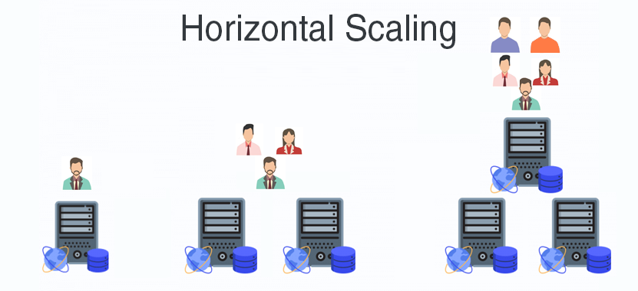
Horizontal Scalability
Notes:
Advantages of Horizontal Scaling
Fault Tolerance means that there is no single point of failure in this kind of scale because there are 5 servers here instead of 1 powerful server. So if anyone of the servers fails then there will be other servers for backup. Whereas, in Vertical Scaling there is single point failure i.e: if a server fails then the whole service is stopped.
Low Latency: Latency refers to how late or delayed our request is being processed.
Built-in backup
Disadvantages of Horizontal Scaling
Not easy to implement as there are a number of components in this kind of scale
Cost is high
Networking components like, router, load balancer are required
https://www.geeksforgeeks.org/overview-of-scaling-vertical-and-horizontal-scaling/

Slide 8
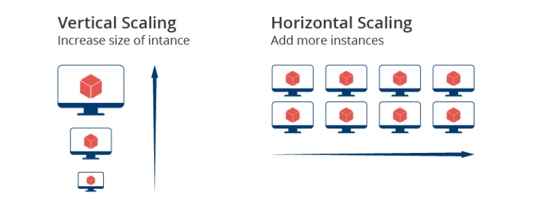
Cloud Scalability
Regional scaling
Load balancers
“Location transparent”

Slide 9
Costs

Slide 10
Scaling & Reporting
Efficient use of resources (less waste)
Costs scale based on service usage (instead of large up-front cost)
ROI and TCO calculations
Predictable Spending
Notes:
Costs scale based on service usage
Generally (hopefully) as your usage goes up, you are making more money as well
Without cloud, you have to forecast your highest usage and then purchase (capex) systems based on that need and they sit idle
Remember our old mainframes? They might sit at 5% most of the time, that’s a lot of wasted money!
Much easier to determine who used what
Also possible to “tag” applications to specific cost centers and profit generators
Analysts can forecast the $$ / user and scale appropriately
No up-front purchases for hardware

Slide 11
CapEx vs OpEx
Capital Expenses
Operational Expenses
Paid up front
Depreciated over time (tax implications)
Paid over time
Taxed at the point of purchase

Slide 12
Agility

Slide 13
Global Accessibility
Employees work remotely
HQ can be anywhere
Anyone can access service anywhere

Slide 14
Disaster Recovery
Service provider’s responsibility
Easily switch to another region
Shift company operations from one site to another

Slide 15
Maintenance and Updates
Physical maintenance inconsequential
Roll updates across services without downtime

Slide 16
Self-service
Any sub-organization or employee can provision services
Can spin-up / down as needed
Need a new product? Rent it for a while

Slide 17
Downsides
Internet connectivity required
Limited control / flexibility
Vendor lock-in
Latency
Management complexity
Customization
Migrations

Slide 18
Migration Strategies

Slide 19
Case Studies

Slide 20
Questions?

